Slide 1
Travel and tourism management
Student name | Student id
N.Rajashri | 2110030283
K.Shivani | 2110030284
S.Nikhitha | 2110030320
SriVarshini Akula | 2110030449

Slide 2
Abstract
The objective of the project is to develop a system that automates the processes and activities of a travel and the purpose is to design a system using which one can perform all operations related to traveling.
Key features of the system include a user-friendly website and Desktop application that allow travelers to effortlessly search for destinations, accommodations, and activities while receiving tailored recommendations based on their preferences. The integration of real-time data updates ensures travelers are informed about changes in schedules, weather conditions, and local events, enhancing their overall experience.

Slide 3
Objectives & Scope
The objective of the travel and tourism management project in Java using JSP and Servlets is to develop a web-based application that allows users to manage various aspects of travel and tourism. The project aims to provide functionalities such as booking flights, hotels, and tour packages, managing customer information, generating invoices, and handling payment transactions.
Scope :
→User Registration and Authentication
→Traveler Features
→Analytical Features
→Database Management

Slide 4
Literature Review
Travel and Tourism management systems | A Travel and Tour Management System is a comprehensive software solution designed to facilitate the efficient management and organization of various aspects of the travel and tourism industry.
Travel businesses | Efficiency and Streamlined Operations Real-Time Availability and Booking Simplified Financial Management
Travellers | Convenience and Accessibility Transparency and Information Access Payment Security
Challenges and Limitations | Takes much time for Refunding the amount Users may not know prior information about the packages

Slide 5
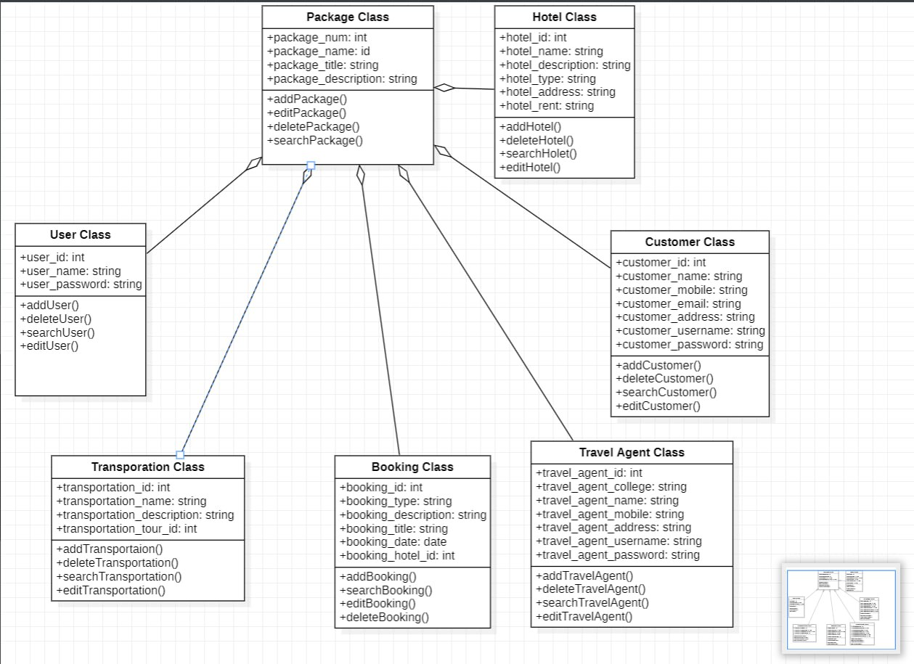
Class Diagram

Slide 6
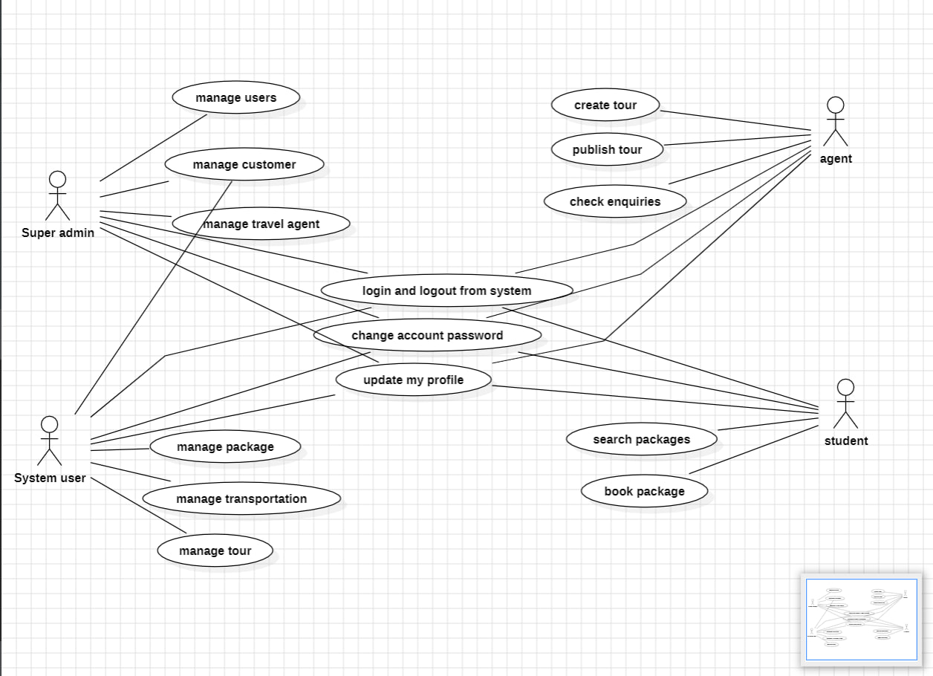
Use Case Diagram

Slide 7
Existing systems
In the present system a customer has to approach various agencies to find details of places and to book tickets.
This often requires a lot of time and effort.
A customer may not get the desired information from these offices and often
the customer may be misguided.
It is tedious for a customer to plan a particular journey and have it executed

Slide 8
Proposed system
The proposed system is a web based application and maintains a centralized
repository of all related information.
The system allows one to easily access the relevant information and make
necessary travel arrangements.
Users can decide about places they want to visit and make bookings online for
travel and accommodation.

Slide 9
fully computerized and user friend
Contactless Technology Adoption
Smart Choices with Data
Advantages
Enhanced Customer Experience
Visitor Satisfaction Analysis
Data Security and Privacy

Slide 10
Hardware Requirements
8 GB RAM for smooth multitasking and development.
Intel core Processor(i5)

Slide 11
Software Requirements
Java (JSP , Servlets) , Bootstrap
NetBeans IDE
MySQL(Data-base)
Operating Systems(windows)

Slide 12
Code
<!DOCTYPE html>
<html>
<head>
<link rel="stylesheet" href="https://stackpath.bootstrapcdn.com/bootstrap/4.5.2/css/bootstrap.min.css" integrity="sha384-JcKb8q3iqJ61gNV9KGb8thSsNjpSL0n8PARn9HuZOnIxN0hoP+VmmDGMN5t9UJ0Z" crossorigin="anonymous" />
<meta charset="UTF-8">
<link rel="stylesheet" href="https://cdn.jsdelivr.net/npm/bootstrap-icons@1.11.1/font/bootstrap-icons.css">
<title>Login or Sign-Up</title>
<style>
.login{
color:#FFFFFF;
font-family:Georgia;
text-align:right;
}
.card1{
height:850px;
width: 1200px;
margin-top: 93px;
margin-left: 150px;
}
.

Slide 13
<a class="carousel-control-prev" href="#carouselExampleIndicators" role="button" data-slide="prev">
<span class="carousel-control-prev-icon" aria-hidden="true"></span>
<span class="sr-only">Previous</span>
</a>
<a class="carousel-control-next" href="#carouselExampleIndicators" role="button" data-slide="next">
<span class="carousel-control-next-icon" aria-hidden="true"></span>
<span class="sr-only">Next</span>
</a>
</div>
</div>
<h1 class="head">Why to use our website</h1>
<div class="text">
</div>
<h1 style="margin-bottom:89px ; text-align:left">Tour Trends and Analytics</h1>
<div id="Section1">
<div class="card2">
<div class='tableauPlaceholder' id='viz1697032043702' style='position: relative'>
<param name='static_image' value='https:&#47;&#47;public.tableau.com&#47;static&#47;images&#47;Bo&#47;Book1_16970318924300&#47;Dashboard1&#47;1.png' />
<param name='animate_transition' value='yes' />
<param name='display_static_image' value='yes' /><param name='display_spinner' value='yes' /><param name='display_overlay' value='yes' /><param name='display_count' value='yes' /><param name='language' value='en-GB' /><param name='filter' if ( divElement.offsetWidth > 800 ) { vizElement.style.width='1000px';vizElement.style.height='827px';} else if ( divElement.offsetWidth > 500 ) { vizElement.style.width='1000px';vizElement.style.height='827px';} else { vizElement.style.width='100%';vizElement.style.height='927px';} var scriptElement = document.createElement('script'); scriptElement.src = 'https://public.tableau.com/javascripts/api/viz_v1.js'; vizElement.parentNode.insertBefore(scriptElement, vizElement);

Slide 14
</div>
</div>
<div id="Contact">
<div class="last" style="text-align:center">
<h1 class="h1">Contact us</h1>
<a href="https://www.linkedin.com/in/konduri-shivani-212953226/" target="_blank">
<i class="bi bi-linkedin icons " style="margin-left:12px"></i>
</a>
<a href="https://github.com/KONDURISHIVANI" target="_blank">
<i class="bi bi-github icons " style="margin-left:12px"></i>
</a>
</div>
</div>
</body>
</html>

Slide 15
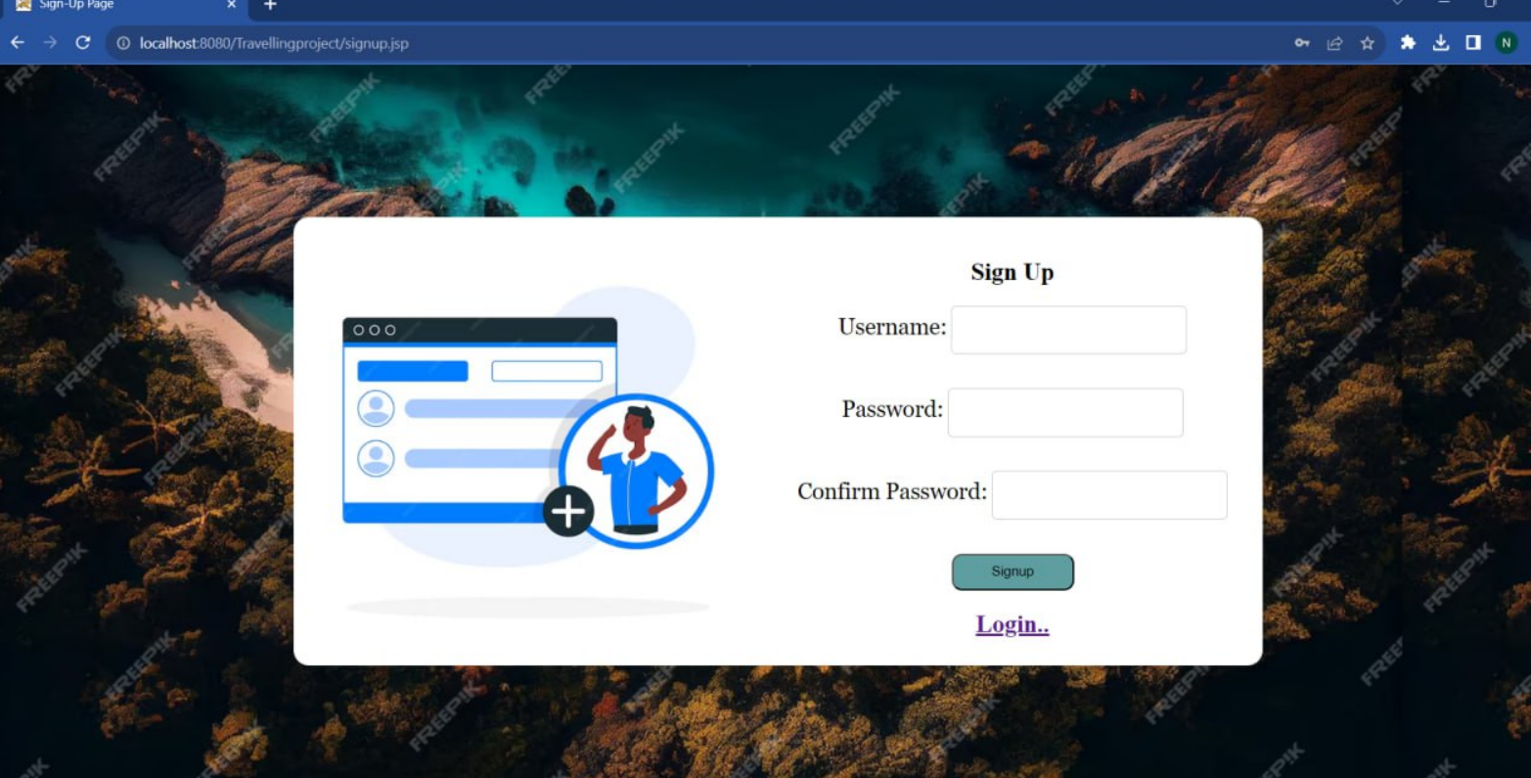
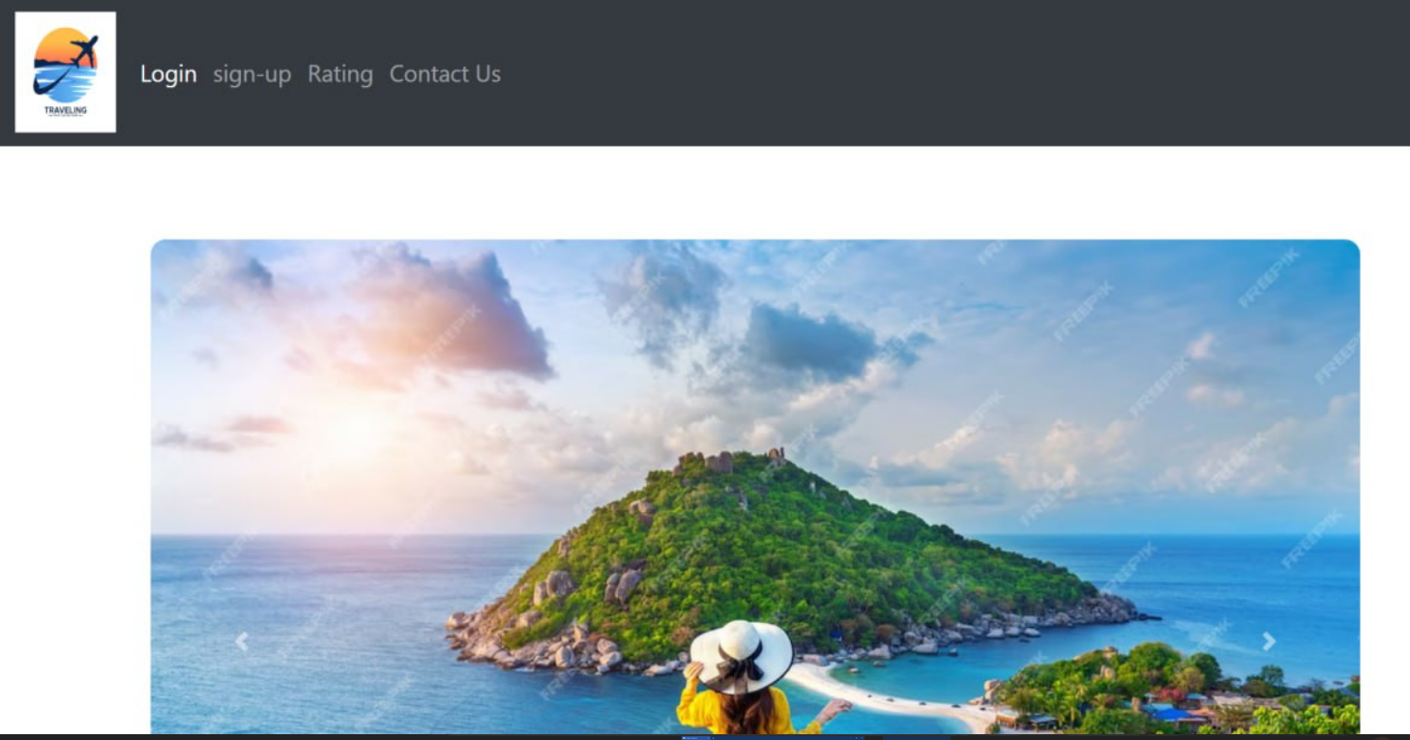
Results

Slide 16
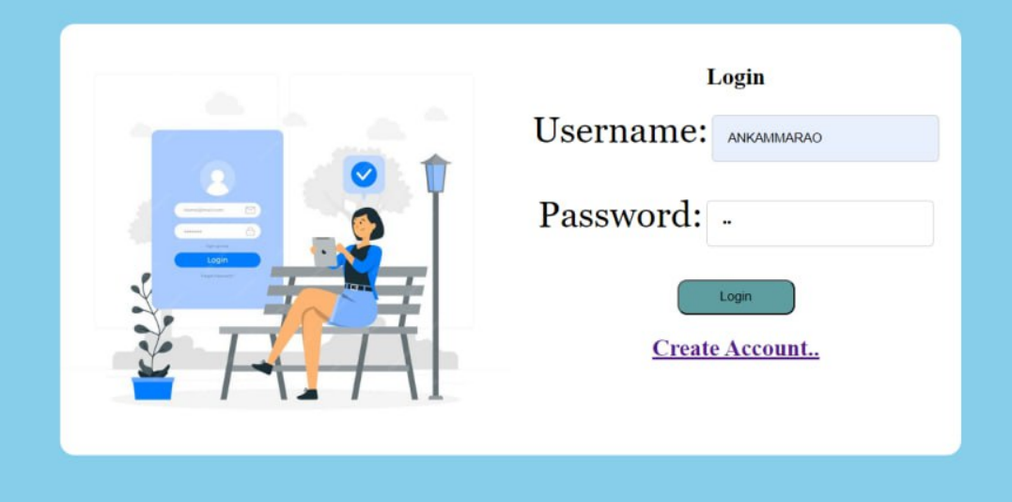
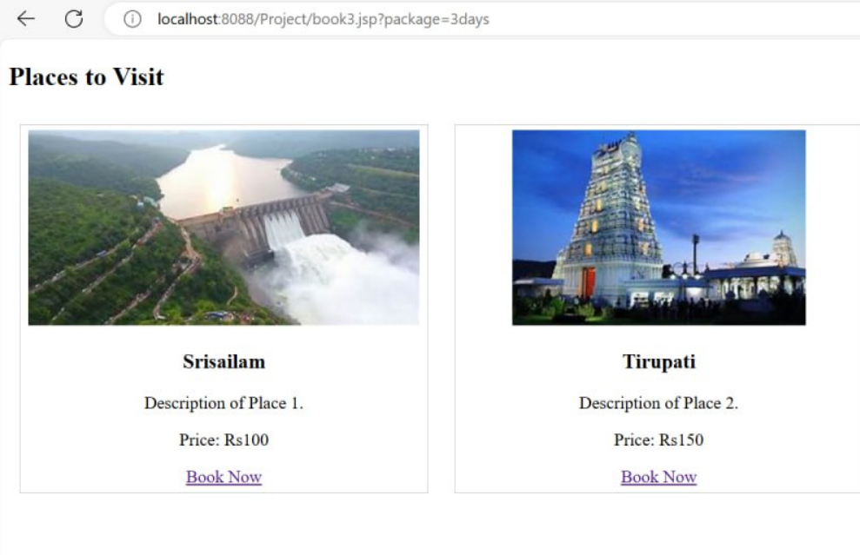

Slide 17
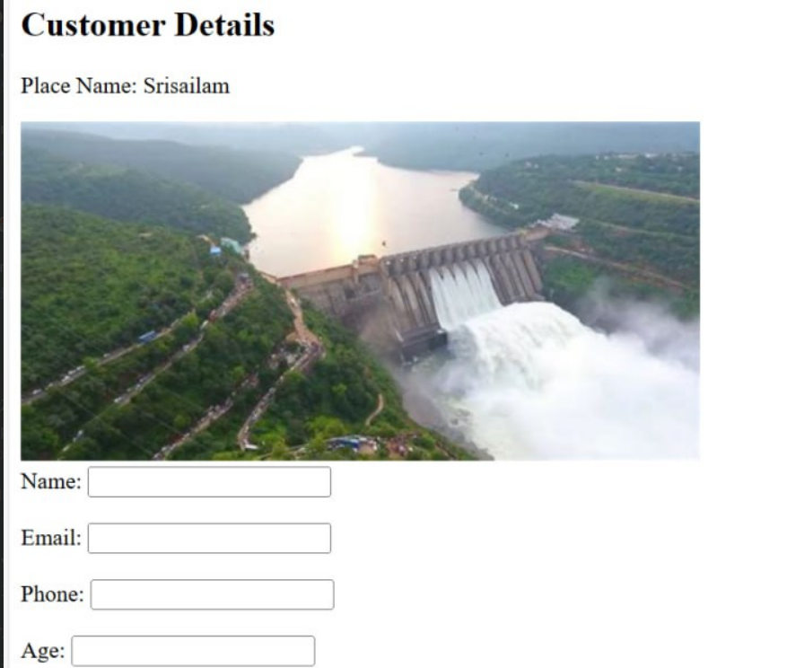
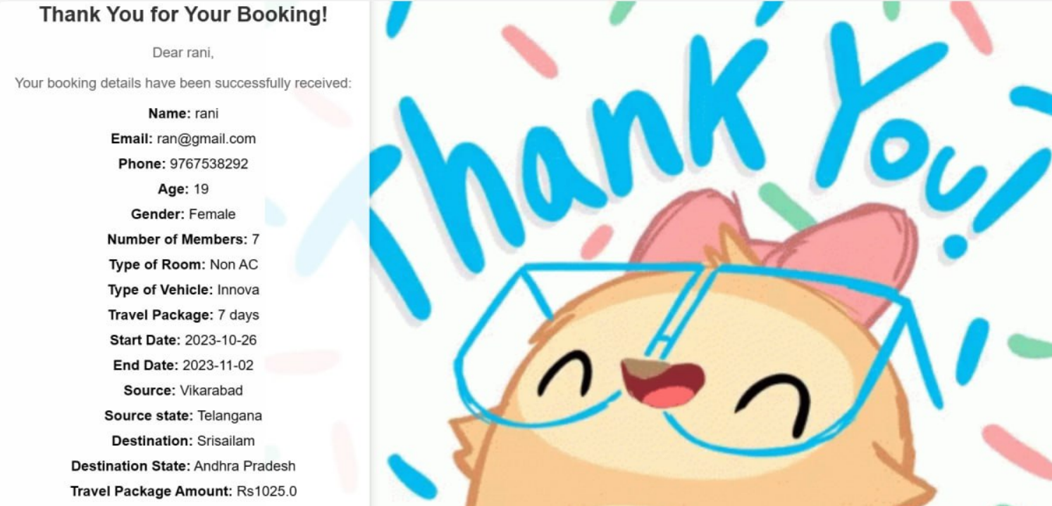

Slide 18
Conclusion
The development of a user-friendly travel and tourism website allows travelers to book accommodations, activities, and experiences has the potential to revolutionize the way people explore and experience the world. The project's primary aim was to create a platform that offers convenience, variety, and personalization to travelers, and it has successfully achieved this goal

Slide 19
Future Scope
→Enhanced User Experience
→Personalization and Recommendation
→Multilingual Support
→Review and Rating System
→Security Enhancements

Slide 20
References
→https://docs.oracle.com/javaee/7/tutorial/index.html
→https://getbootstrap.com/docs/5.0/getting-started/introduction/
→Sample Projects and Tutorials
→www.wekiped.a.com
→www.w3schools.com

Slide 21
THANK YOU

